Slide 1
USAWOA Past President Council (PPC)
AUGUST 2022

Slide 2
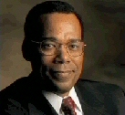
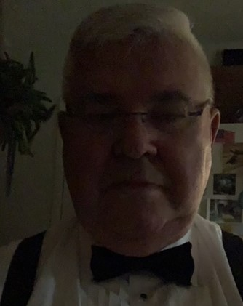
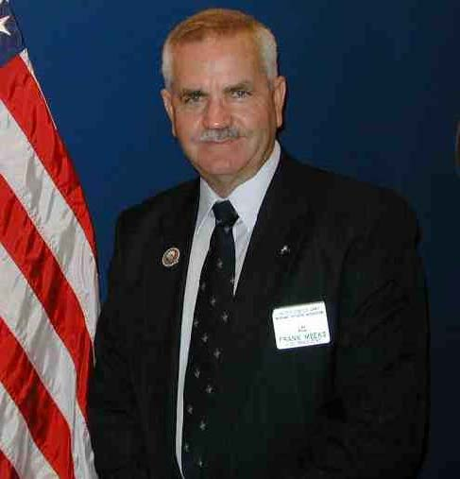
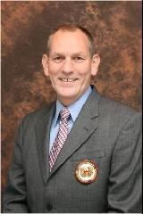
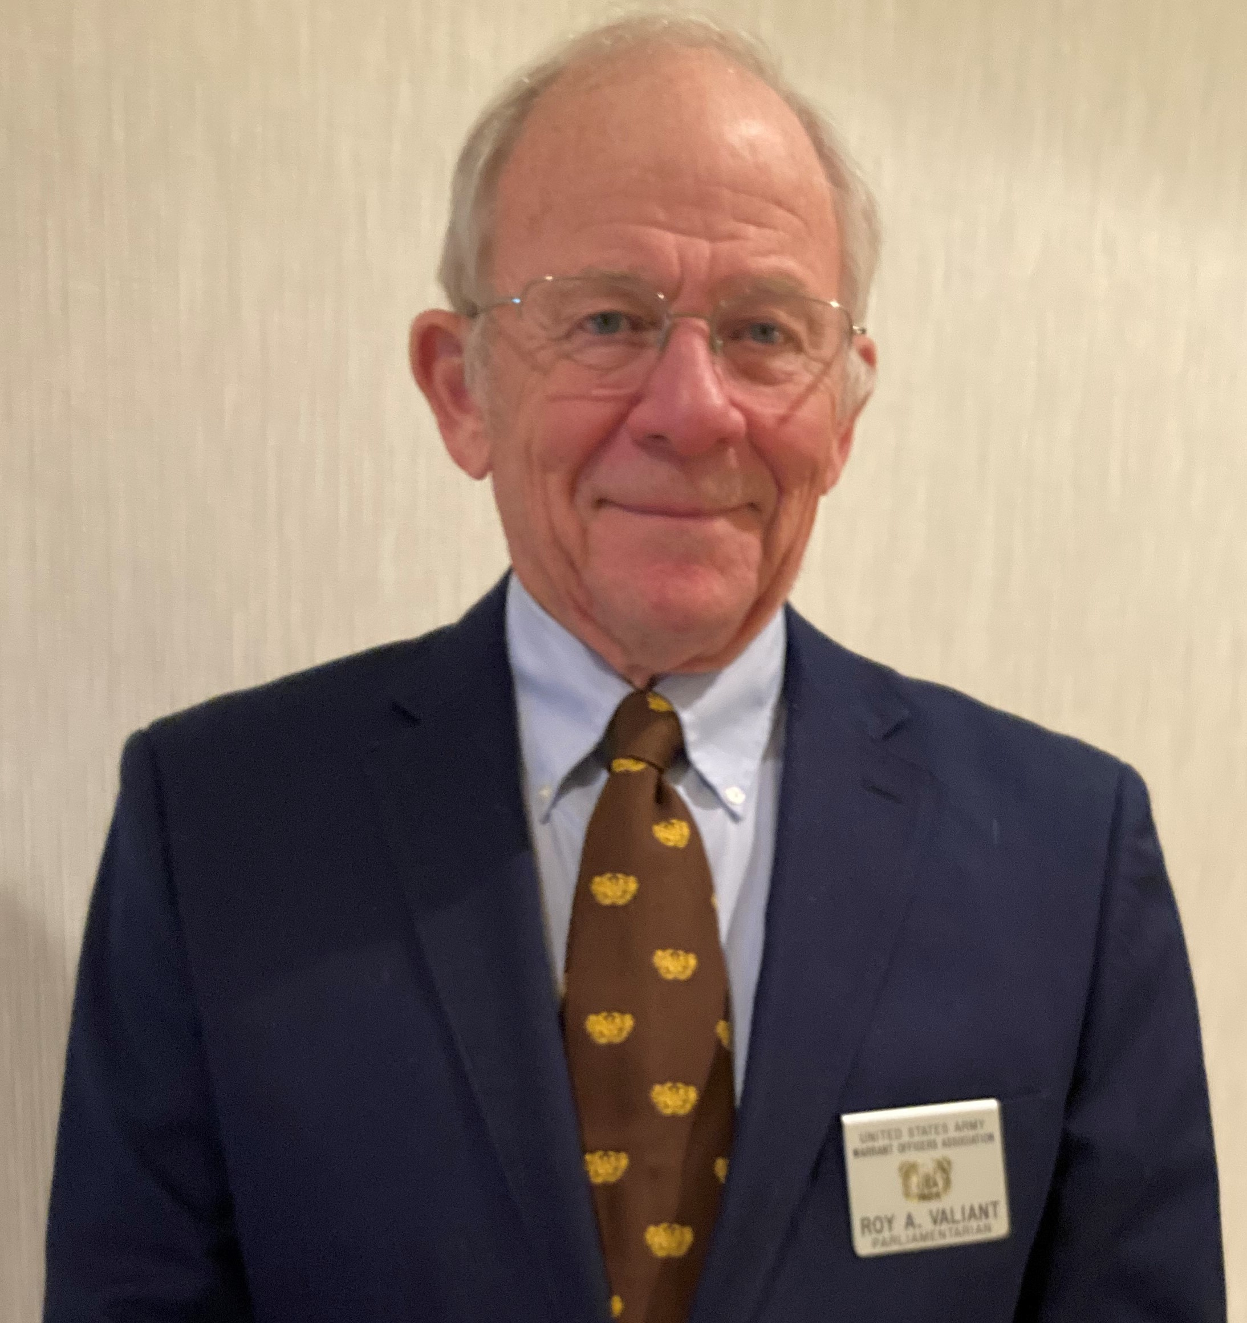
Past Presidents Council http://ppc.usawoa.org
CW4 (Ret) Carl M. Burnett Chairman
Past National President 1984-1986
CW4 (Ret) Ronald J. Whalen
Past National President
1982-1984
Past Northeastern Region President
1985-1987
CW5 (Ret) Franklin D. Meeks
Past National President
2000-2004
CW4 (Ret) Roy Valiant
Past National President 2004-2008 Past European Region President 1990 - 1993 / 1996 - 2000
CW4 (Ret) Kenneth B. N. Hill
Past National President
2010-2012

Slide 3
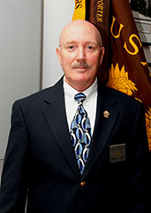
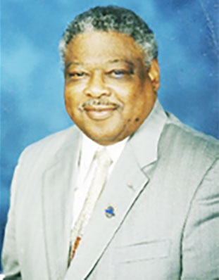
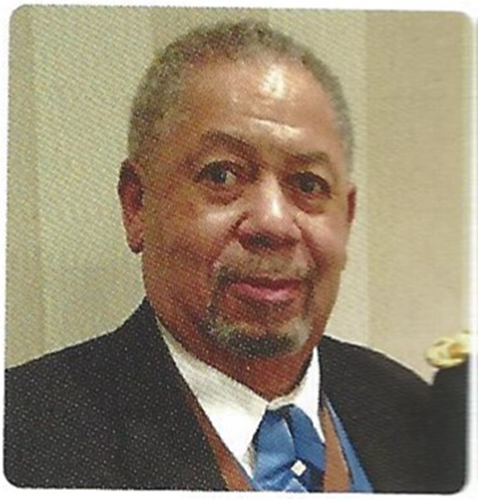
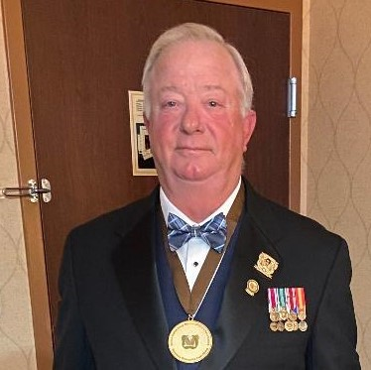
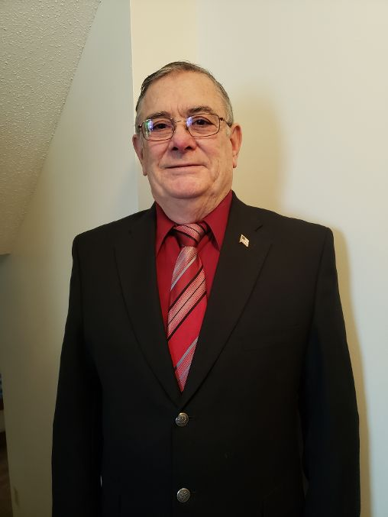
Past Presidents Council http://ppc.usawoa.org
CW3 (Ret) James E. Wilson
Past European Region President
1985-1986
2005-2006
CW4 (Ret) Gregory A. Gouty
Past National President
2016-2018
CW4 (Ret) Percy Butler
Past European Region President
1980-1981
CW2 (Ret) Gerald J. Wentworth
Past European Region President
1993-1995
CW5 (Ret) Howard Lundin
Past Northeastern Region President 1989-1992

Slide 4
PPC Proposals 2021
PPC Proposal No. | Proposal Title | Status
PPC-2021-01 | Past Presidents Council (PPC) Charter | To EXCOM Feb 2021
PPC-2021-02 | Enhanced Membership Program | To EXCOM Feb 2021
PPC-2021-03 | New Format for USAWOA Legislative Initiatives | To EXCOM Feb 2021
PPC-2021-04 | WOA-MOAA Membership Program | Tabled
PPC-2021-05 | Eagle Rising Society Programs | To EXCOM Feb 2021
PPC-2021-06 | Redesign of the WOA Portal | To EXCOM Feb 2021
PPC-2021-07 | Honorary WO Membership Awards | EXCOM Approved Jun 2021
PPC-2021-08 | Redesign of the USAWOA.org | To EXCOM Feb 2021
PPC-2021-09 | Liability Insurance for Chapters | Ongoing
PPC-2021-010 | USAWOA Digital Library | To EXCOM Apr 2021

Slide 5
PPC Proposals 2022
PPC Proposal No. | Proposal Title | Status
PPC-2022-01 | USAWOA Leadership Coaching Program (LCP) | TO EXCOM 12/4/2021
PPC-2022-02 | 501c(19) IRS Nonprofit Status | TO EXCOM 1/22/2022
PPC-2022-03 | Honorary Award Selection Process | TO EXCOM 12/4/2021
PPC-2022-04 | Exec VP Historian | TO EXCOM 12/4/2021
PPC-2022-05 | USAWOA Corporate Membership Plan | TO EXCOM 1/22/2022
PPC-2022-06 | CCWO Membership Initiative | TO EXCOM 12/4/2021
PPC-2022-07 | New HQ Organizational Structure | TO EXCOM 1/22/2022
PPC-2022-08 | Infostructure Transition Management Plan (ITMP) | Update TO EXCOM 8/27/2022
PPC-2022-09 | Structural Realignment Plan (SRP) | TO EXCOM 1/22/2022
PPC-2022-10 | New Income Categories | TO EXCOM 1/22/2022

Slide 6
PPC Proposals 2022
PPC Proposal No. | Proposal Title | Status
PPC-2022-11 | USAWOA Financial Audit | TO EXCOM 8/27/2022
PPC-2022-12 | USAWOA Leadership Non-Profit Training | TO EXCOM 8/27/2022

